Slide 1

Transmission lines (T.L.) performance

Slide 2
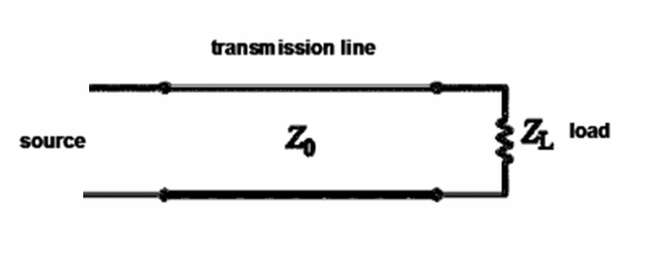
Transmission line voltage reflection coefficient

Slide 3


Slide 4
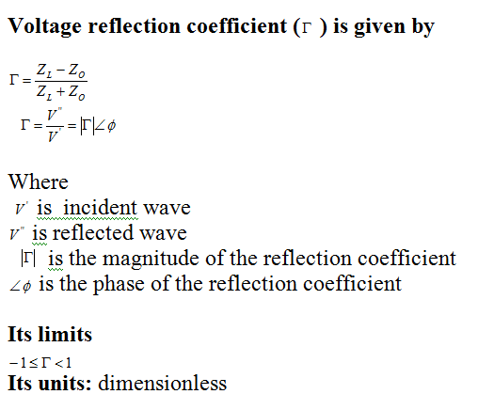

Slide 5
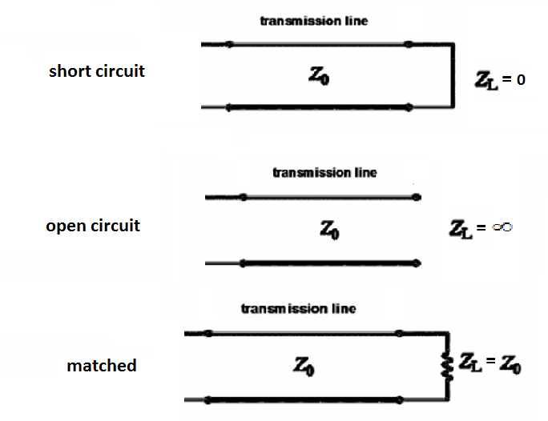
Voltage reflection coefficient special cases

Slide 6
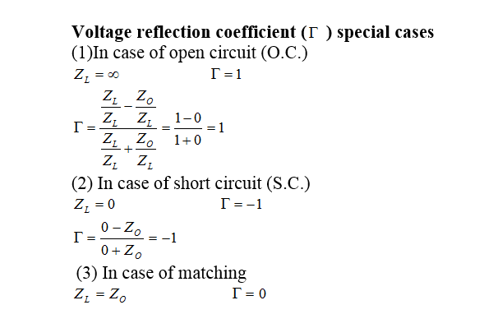

Slide 7


Slide 8
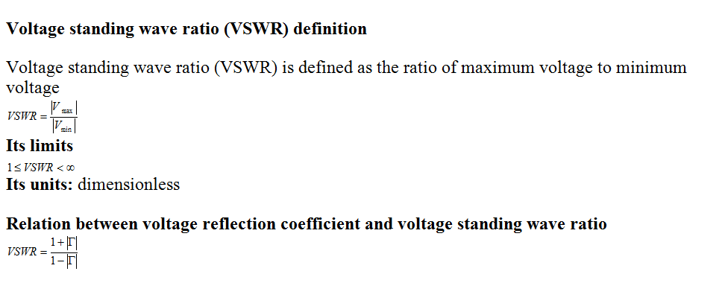

Slide 9
VSWR special cases

Slide 10
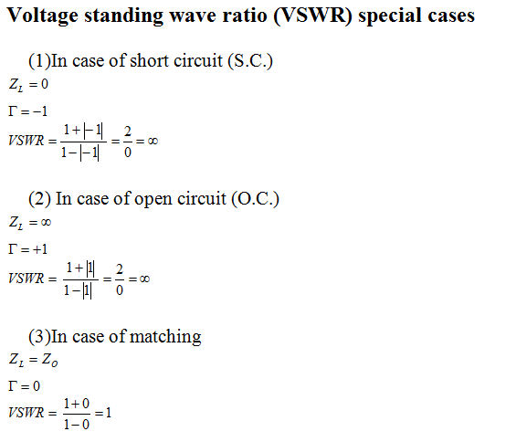

Slide 11
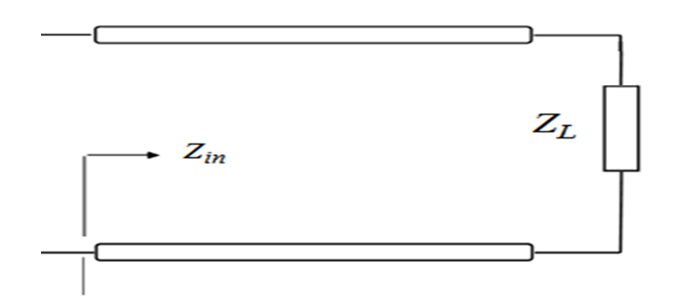
Transmission line input impedance

Slide 12
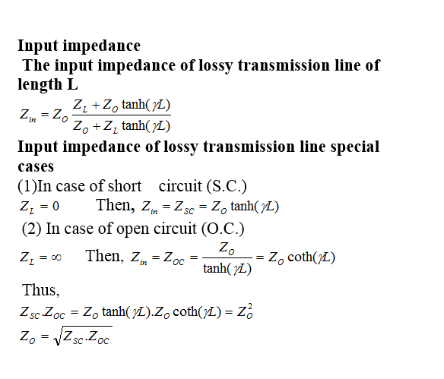

Slide 13
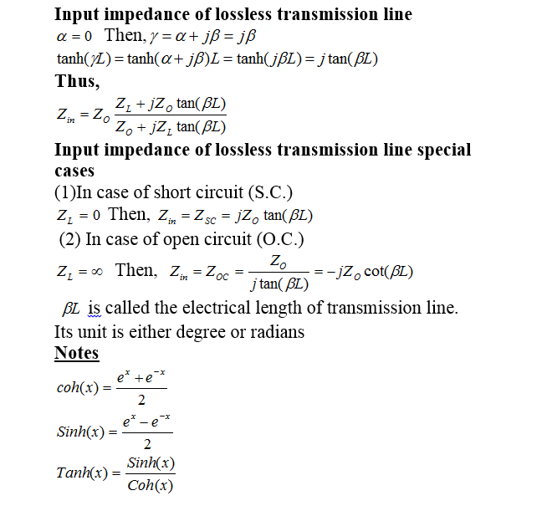

Slide 14
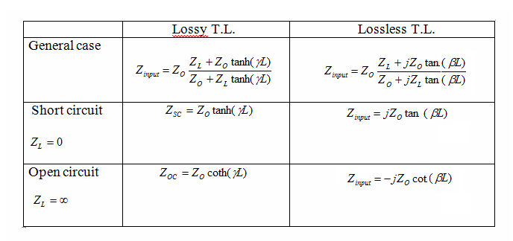
Comparison between lossy and lossless T.L. input impedance of length L

